Slide 1
Office of Research Services
Introduction & All About Grants
Loyola University of Chicago
6439 N Sheridan Road
Granada Center, 4th Floor
Chicago, IL 60660-5309
Phone: 773.508.2471
Email: ors@luc.edu
www.luc.edu/ors

Slide 2
Introduction by Angelica Vaca,
Director of the Office of Research Services

Slide 3

FINDING FUNDING
Adding Keywords to your PTAP Profile
Internal Grants administered by ORS
PIVOT Database

Slide 4
PTAP
PROPOSAL
TRANSMITTAL
APPROVAL
PROCESS
PTAP is a University document that must be completed online by faculty (or a Research Administrator on behalf of the faculty member) planning to submit a proposal for a research, training or other initiative to an external sponsor.
http://ptap.luc.edu

Slide 5

Why should you select keywords in your PTAP Profile?
When you add keywords to your PTAP User Profile, you will periodically receive external funding opportunities via email that correspond with your research interests (keywords).
The keywords listed in PTAP are the same keywords used in PIVOT (Funding opportunities & expertise database).
If you have NO keywords listed in your profile, you may be
missing out on potential funding opportunities…Oh No!!

Slide 6
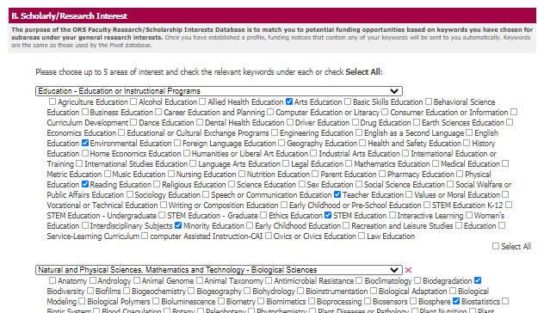
How to add Keywords to your PTAP Profile
Log into www.ptap.luc.edu
Click on “Update Your Profile”
In section B-Scholarly/Research Interest, click “edit”
You may choose up to 5 areas of interest and check the relevant keywords under each area (or select all).
When finished, click “Update”

Slide 7
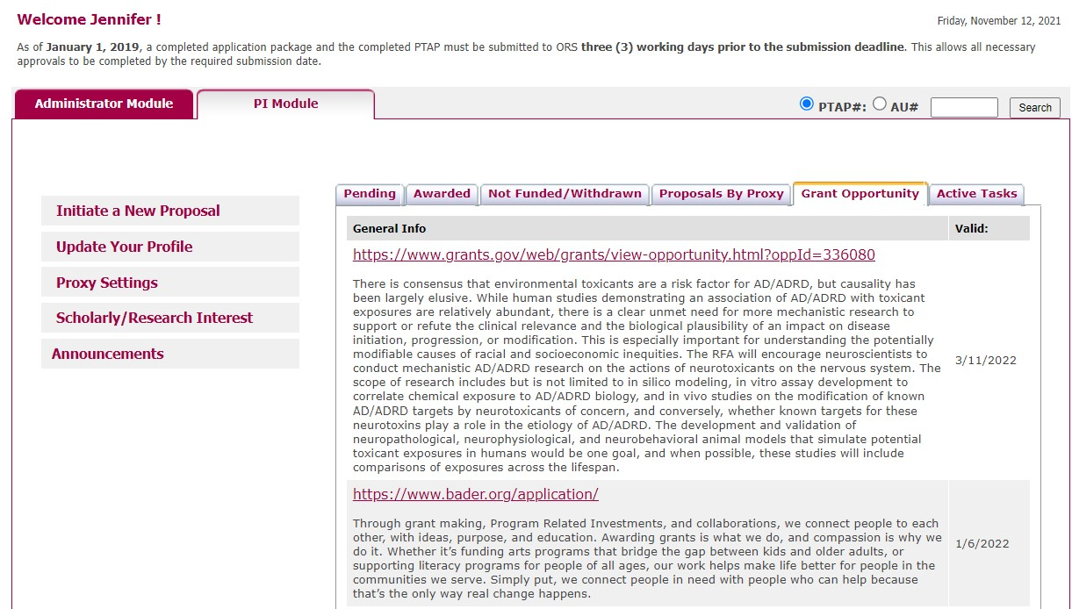
Your funding opportunities can be viewed in PTAP as well!
In addition to receiving an email when a funding opportunity matches your chosen research interests in PTAP, you can also view those opportunities when you log into the PTAP system by clicking on the tab titled “Grant Opportunity.”

Slide 8

PIVOT Funding Database
The Pivot database provides access to the most comprehensive global source of funding opportunities and provides scholarly profiles to match researchers with financial partners and collaborators. When you create your Pivot profile, you can:
  Sign up to receive customized funding alerts
  Save and return to previous funding searches
  Share funding opportunities directly from Pivot
  Track individual funding opportunities
https://pivot.proquest.com
FREE for
LUC users!
Directions on how to create a PIVOT Profile can be found on the
ORS main page at www.luc.edu/ors

Slide 9

ADDITIONAL FUNDING RESOURCES
You
Can
Do
It!
https://www.grants.gov/web/grants/home.html
https://beta.nsf.gov/funding/opportunities
https://grants.nih.gov/funding/index.htm
https://www.neh.gov/grants/listing?keywords=&page=1
Look at various Agency and Institute website directly.

Slide 10




ORS Internal Grants

Slide 11
Internal Grants Administered by ORS
Research Support Grant (RSG): Similar to seed grants. RSG’s help faculty with securing preliminary data in order to apply for larger external funding. RSG’s are awarded up to $5,000.
Manuscript Publication Assistance (MPA): MPA assists faculty with fees associated with the preparation of scholarly manuscripts or creative artwork for publication or presentation. ORS will cover 50% of the total cost up to $1,000.
Book Subvention: Aids faculty in the costs of publishing scholarly books. Book Subvention grants will cover up to $2,000.
Grants available through the office of
The Vice Provost for Research include:
  J.E.D.I (Justice, Equity, Diversity and Inclusion)
  Transformative Grant Award
Information regarding these internal grant opportunities
can be found at: https://luc.infoready4.com/

Slide 12
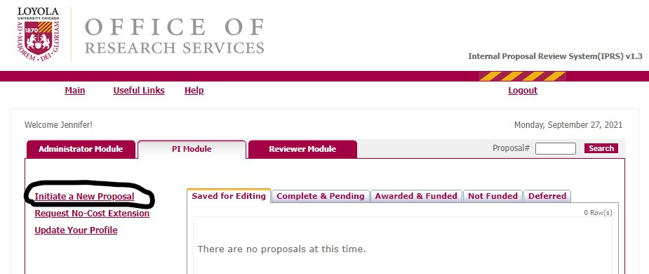
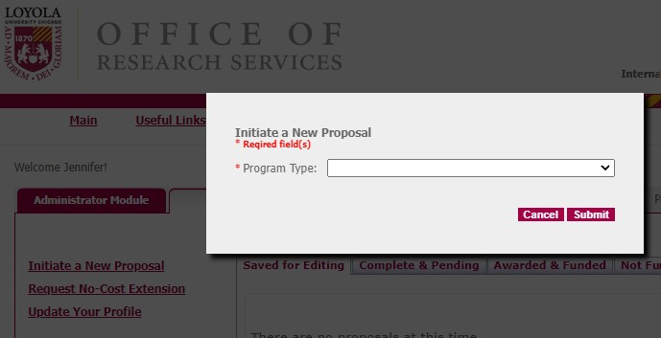
Eligibility & How to Apply
All full time faculty (Tenured, TT, & NTT) from the Water Tower and Lakeshore Campuses are eligible to apply for ORS Internal Grants.
Login to IPRS at https://iprs.luc.edu
Click “Initiate a New Proposal”
Choose the internal grant you want to apply for from the drop down list.
Follow the prompts to apply.

Slide 13
ORS Internal Grant Deadlines & ORS Contact Information
Deadlines
ORS Contact Information
Manuscript Publication Assistance (MPA) and Book Subvention Grants have a rolling deadline.
Research Support Grants (RSG) deadlines are August 1st, November 1st, February 1st, and May 1st, unless otherwise noted.
ORS Contact Information:
Office of Research Services (ORS)
6439 N. Sheridan Road
Granada Center, Ste. 400
Phone: 773-508-2471
Email: ors@luc.edu
www.luc.edu/ors

Slide 14
Research Integrity and Compliance
Andrew Ellis
Associate Director of Research Compliance
aellis5@luc.edu

Slide 15
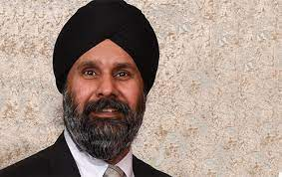
Introduction
Greeting
A branch of ORS dedicated to ensuring compliance with the regulations.
Working with our Institutional Official, Dr. Singh (Vice Provost for Research)
Titles: Vice Provost for Research
Professor in Department of Cellular and Molecular Physiology
Specialty Area: Cellular and Molecular Physiology
Email: msingh@luc.edu

Slide 16
Areas of Research Compliance
Human Subject Research
Laboratory Animals (for research or teaching)*
Biological and Chemical Hazards*
Radiation*
Responsible Conduct Training- “RCRS”*

Slide 17
Human Subject Research……
Requires oversight of the LUC IRB
Must obtain approval before involving any human subject in research.
Three “levels of review”
  Convened
  Expedited
  Exempt
Training Requirements
  CITI Program
Applications are done online
  CAP system

Slide 18

What Regulations are Important?
Department of Health and Human Service “The Common Rule”
  January, 2019 became the “Final Rule”
  45 CFR 46: https://www.hhs.gov/ohrp/regulations-and-policy/regulations/45-cfr-46/index.html
The FDA
The Belmont Report
The Privacy Rule (HIPAA)
Others that might affect your project? ….FERPA….mandatory reporting requirements……..etc.

Slide 19

Definitions
Human subject means a living individual about whom an investigator (whether professional or student) conducting research obtains
  (1) Data through intervention or interaction with the individual, or
  (2) Identifiable private information.
  Research: Research means a systematic investigation, including research development, testing and evaluation, designed to develop or contribute to generalizable knowledge. Activities which meet this definition constitute research for purposes of this policy, whether or not they are conducted or supported under a program which is considered research for other purposes. For example, some demonstration and service programs may include research activities.

Slide 20
TRAINING: IRB Requires CITI Training
All personnel engaged in research with human subjects must obtain IRB certification by completing an on-line training course. The course, provided by the University of Miami, is called the Collaborative IRB Training Initiative (CITI) course. Completion of the CITI course quizzes with an overall score of 80 percent is required for certification. IRB certification is valid for three years and is required for IRB approval of a research project.
www. luc.edu/ors/pdfs/IRB/FLYERCITIinstruction.doc

Slide 21

citiprogram.org
Step 1: Log In
  Use LUC Username and Password.
  Should walk you through setup questions.
    SELECT “LUC Sponsored Research Personnel”
Step 2: Complete required readings and quizzes
Step 3: After 3-5 days check your date in CAP
Step 4: Watch for renewal notice, must be redone at least every 3 years.
Contact ORS with any problems.

Slide 22
Student Research
All Applications by LUC students must have a faculty sponsor who agrees to supervise the student and bear responsibility for the project. This applies to all projects that are being conducted for the purpose of a degree as well as to all independent research projects.
Note: Does not need to be a member of student’s dissertation committee. Does require current CITI training to be on file with ORS.
If the purpose of the research project is towards the completion of a Masters or Dissertation:
  The project must be approved by the student’s committee before the project is submitted for IRB review.
  PLEASE NOTE: The Graduate School requires IRB approval before approving a Thesis or Dissertation Proposal. After the committee members have approved the proposal, the committee members should sign the Ballot for the Approval of a Thesis/Dissertation Proposal. A copy of this form should be submitted both to the Graduate School and to the IRB. The IRB will notify the Graduate School when a student's protocol has received final IRB approval. After the Graduate School is notified that the student's protocol has received final IRB approval the Graduate School will approve the Thesis/Dissertation proposal, provided everything else is in order.

Slide 23

Additional IRB Resources
Department of Health and Human Services has the regulations online:
  http://www.hhs.gov/ohrp/humansubjects/guidance/45cfr46.htm
Human Subject Regulations Decision Charts:
  http://www.hhs.gov/ohrp/humansubjects/guidance/decisioncharts.htm
  US Department of Education – “Protection of Human Subjects in Research”:
  https://www2.ed.gov/about/offices/list/ocfo/humansub.html

Slide 24
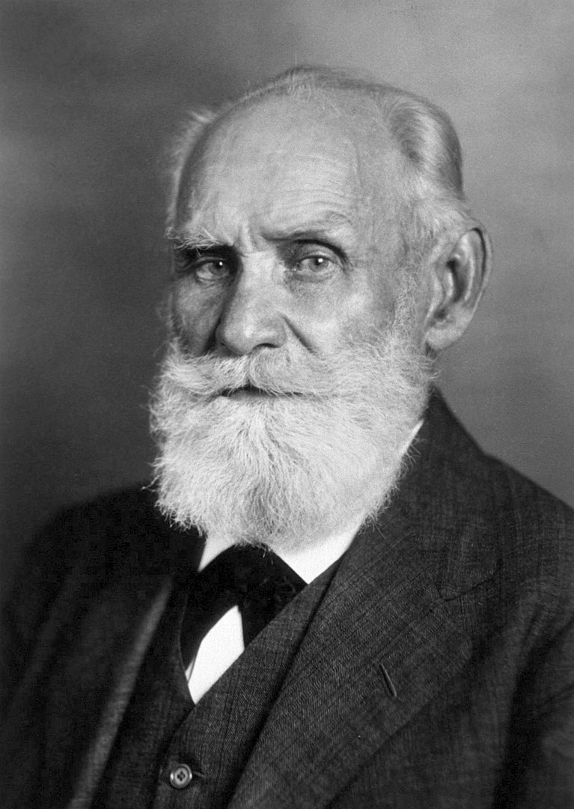
Animal Use In Research & Education
Any use of live vertebrate animals on/off campus needs to have IACUC oversight.
Approval must be obtained in advance.
Research team needs to have completed online training and have a current tetanus inoculation statement with the application.
Most animals are housed in the Animal Care Facility (ACF) in the Quinlan Life Science Building
Should work with the LUC Attending Veterinarian (Contact Andy for help)
Applications are done online using the CAP system.

Slide 25
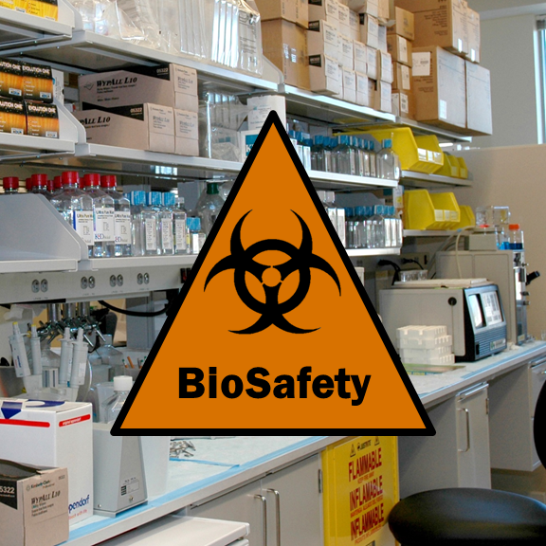
Biosafety
The Institutional Biosafety Committee (IBC)
    Meets about 3 times a year
Biosafety Officer is Dr. Bryan Pickett (Biology Department)
Reports to the National Institutes of Health (NIH) annually
Loyola University Chicago takes very seriously its obligation to oversee research and instruction that involves biohazardous materials and/or recombinant DNA.
Before initiating any work involving biohazardous materials and/or recombinant DNA, whether supported by external funding or not, principal investigators are required to have their protocol approved by the Institutional Biosafety Committee (IBC).
Seek approval before ordering/purchasing/acquiring material

Slide 26

Radiation Safety Program
Radiation Safety Committee
  Meets about 4-6 times a year
Radiation Safety Officer Eli Port (RSSI)
RSSI a safety company that does inspections and surveying, training, and assists with the licensing requirements
Must have approval of the RSC to have or use any radioactive materials
Must report any equipment (produces radiation or laser energy) to Andrew and the RSO
Laser Safety is included

Slide 27
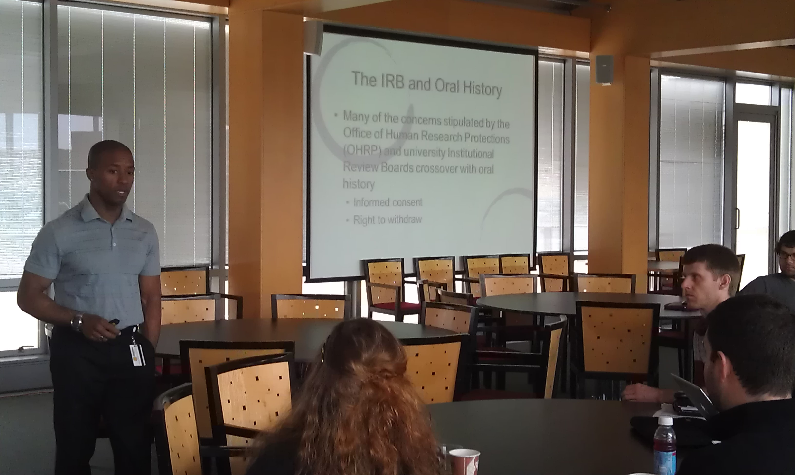
Responsible Conduct of Research and
Scholarship Program
Required “RCR” for people funded by the NSF or NIH.
Required for any graduate student that conducts “research”
  Thesis or Dissertation
UNIV 370
  Two Day program
  Usually scheduled during breaks
  Next session is in January
  Faculty members can register by contacting Andy

Slide 28

Tips
Consider the requirements for using human subjects or animals in your research from the start.
Plan your applications in advance (including renewals 30-45 days before expiration)
Report any concerns or issues as soon as possible.
Do not hesitate to contact Andy or a compliance assistant for help.

Slide 29

Resources-Contact Information
The ORS web site www.luc.edu/ors
Research Compliance web site
  http://www.luc.edu/ors/compliance.shtml
Contact me anytime
Andrew Ellis
Associate Director of Research Compliance
aellis5@luc.edu
(773) 508-2689

Slide 30

Hmmm, I‘m thinking of submitting a proposal. Where do I start?

Slide 31
Proposal & Budget Preparation
Contact ORS
ORS@luc.edu

Slide 32
Key to a Successful Submission:
Early contact and coordination with your Research Administrator
ORS will need:
RFP –Request for proposal-
Sponsor Guidelines
*Do’s
*Don’ts

Slide 33
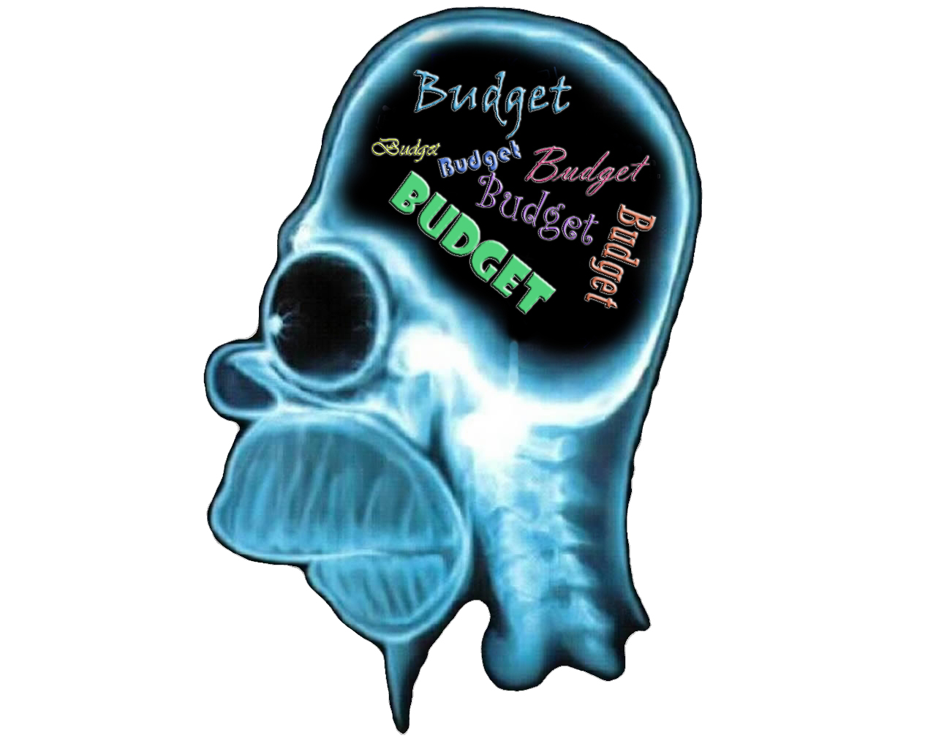
What’s on your mind??

Slide 34
What Makes an Adequate Budget?
Reflects goals
Clear (Narrative)
Realistic
Adheres to guidelines & policies

Slide 35

RULE 1
RULE 2
Develop a Realistic Budget!
Justify Your Needs

Slide 36
Indirect Costs
An indirect cost rate is a measure used by sponsors
to determine what proportion of indirect costs should
be charged to funded programs.
45.50% research
40% Other Sponsored Projects
26% Off Campus

Slide 37
S | Yes | Will they contribute substantively to the project's scientific /programmatic aspect and will they be responsible for decision making? | No | I
U
 |  |  |  | Independent
B
 | Yes | Will they be responsible for adherence to the applicable federal compliance? | No
 |  |  |  | C
 |  |  |  | Contractor
A | Yes | Do they provide the same services and goods to others within normal operations? | No
 |  |  |  | S
W
A |  |  |  | Services
R | Yes | Do they operate in a competitive enrovronment for the provisioning of the goods or services | No
D

Slide 38
What is PTAP?
Proposal Transmittal and Approval Process
https://ptap.luc.edu
*PI completes and submits to ORS-
*Complete and final version ..3 (Three) days prior to deadline
*Institutional Approval
*Houses the story of your Project
*From Sunrise to Sunset of your project
*Programmatic Reporting
*University Officials access to view your submissions

Slide 39

Key Take Away
Contact Early-Contact Often
Claudia Orellana: corellana1@luc.edu
Andrew Ellis: aellis5@luc.edu
Angelica Vaca: avaca1@luc.edu

Slide 40


